Slide 1
18CYB101J - CHEMISTRY
MODULE - I

Slide 2

Quantum Mechanics
The Schrodinger Equation is “First Principle” of non-relativistic quantum mechanics. The solutions of the Schroedinger Equation can provide any information of electrons within atoms and molecules, which enables the prediction of their physiochemical properties and chemical reactions.

Slide 3
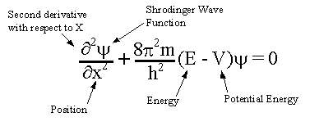
Schrodinger equation
At the beginning of the twentieth century, experimental evidence suggested that atomic particles were also wave-like in nature. For example, electrons were found to give diffraction patterns when passed through a double slit in a similar way to light waves. Therefore, it was reasonable to assume that a wave equation could explain the behaviour of atomic particles. Schrodinger was the first person to write down such a wave equation. The eigenvalues of the wave equation were shown to be equal to the energy levels of the quantum mechanical system, and the best test of the equation was when it was used to solve for the energy levels of the Hydrogen atom, and the energy levels were found to be in accord with Rydberg's Law.

Slide 4
Schrödinger Wave Equation
(1) Schrodinger wave equation is given by Erwin Schrödinger in 1926 and based on dual nature of electron. (2) In it electron is described as a three dimensional wave in the electric field of a positively charged nucleus. (3) The probability of finding an electron at any point around the nucleus can be determined by the help of Schrodinger wave equation which is,
∂²Ψ/∂x² + ∂²Ψ/∂y² + ∂²Ψ/∂²Z² + 8π²m/h²(E-V)Ψ = 0 Where x,y, and z are the 3 space co-ordinates, m = mass of electron, h = Planck’s constant, E = Total energy, V = potential energy of electron,Ψ = amplitude of wave also called as wave function, ∂ = for an infinitesimal change. (4) The Schrodinger wave equation can also be written as, ∇²Ψ + (8π²m/h²) (E-V) Ψ = 0 Where ∇ = laplacian operator.

Slide 5
(5) Physical significance of Ψ and Ψ² (i) The wave function Ψ represents the amplitude of the electron wave. The amplitude Ψ is thus a function of space co-ordinates and time i.e. Ψ = Ψ (x,y,z.....times) (ii) For a single particle, the square of the wave function (Ψ²) at any point is proportional to the probability of finding the particle at that point. (iii) If Ψ² is maximum than probability of finding e⁻ is maximum around nucleus and the place where probability of finding e⁻ is maximum is called electron density, electron cloud or an atomic orbital. It is different from the Bohr’s orbit. (iv) The solution of this equation provides a set of number called quantum numbers which describe specific or definite energy state of the electron in atom and information about the shapes and orientations of the most probable distribution of electrons around the nucleus.

Slide 6
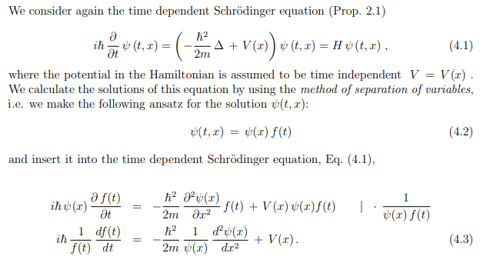
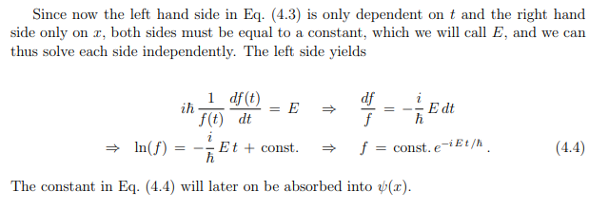

Slide 7
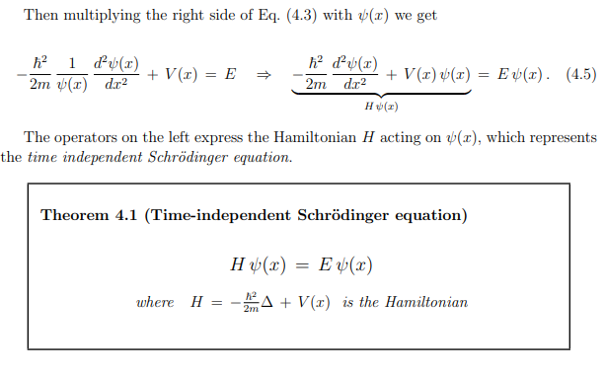

Slide 8
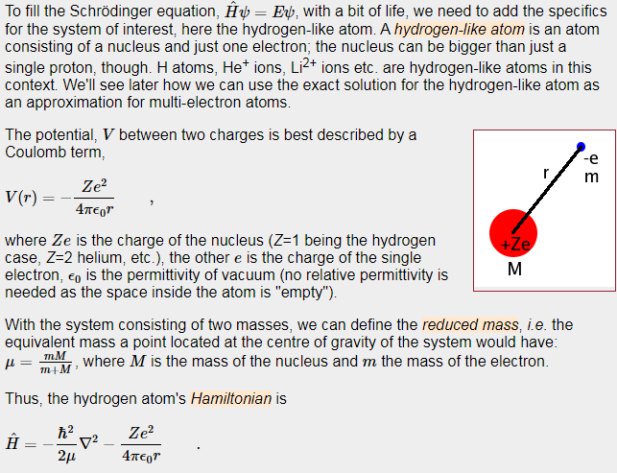

Slide 9
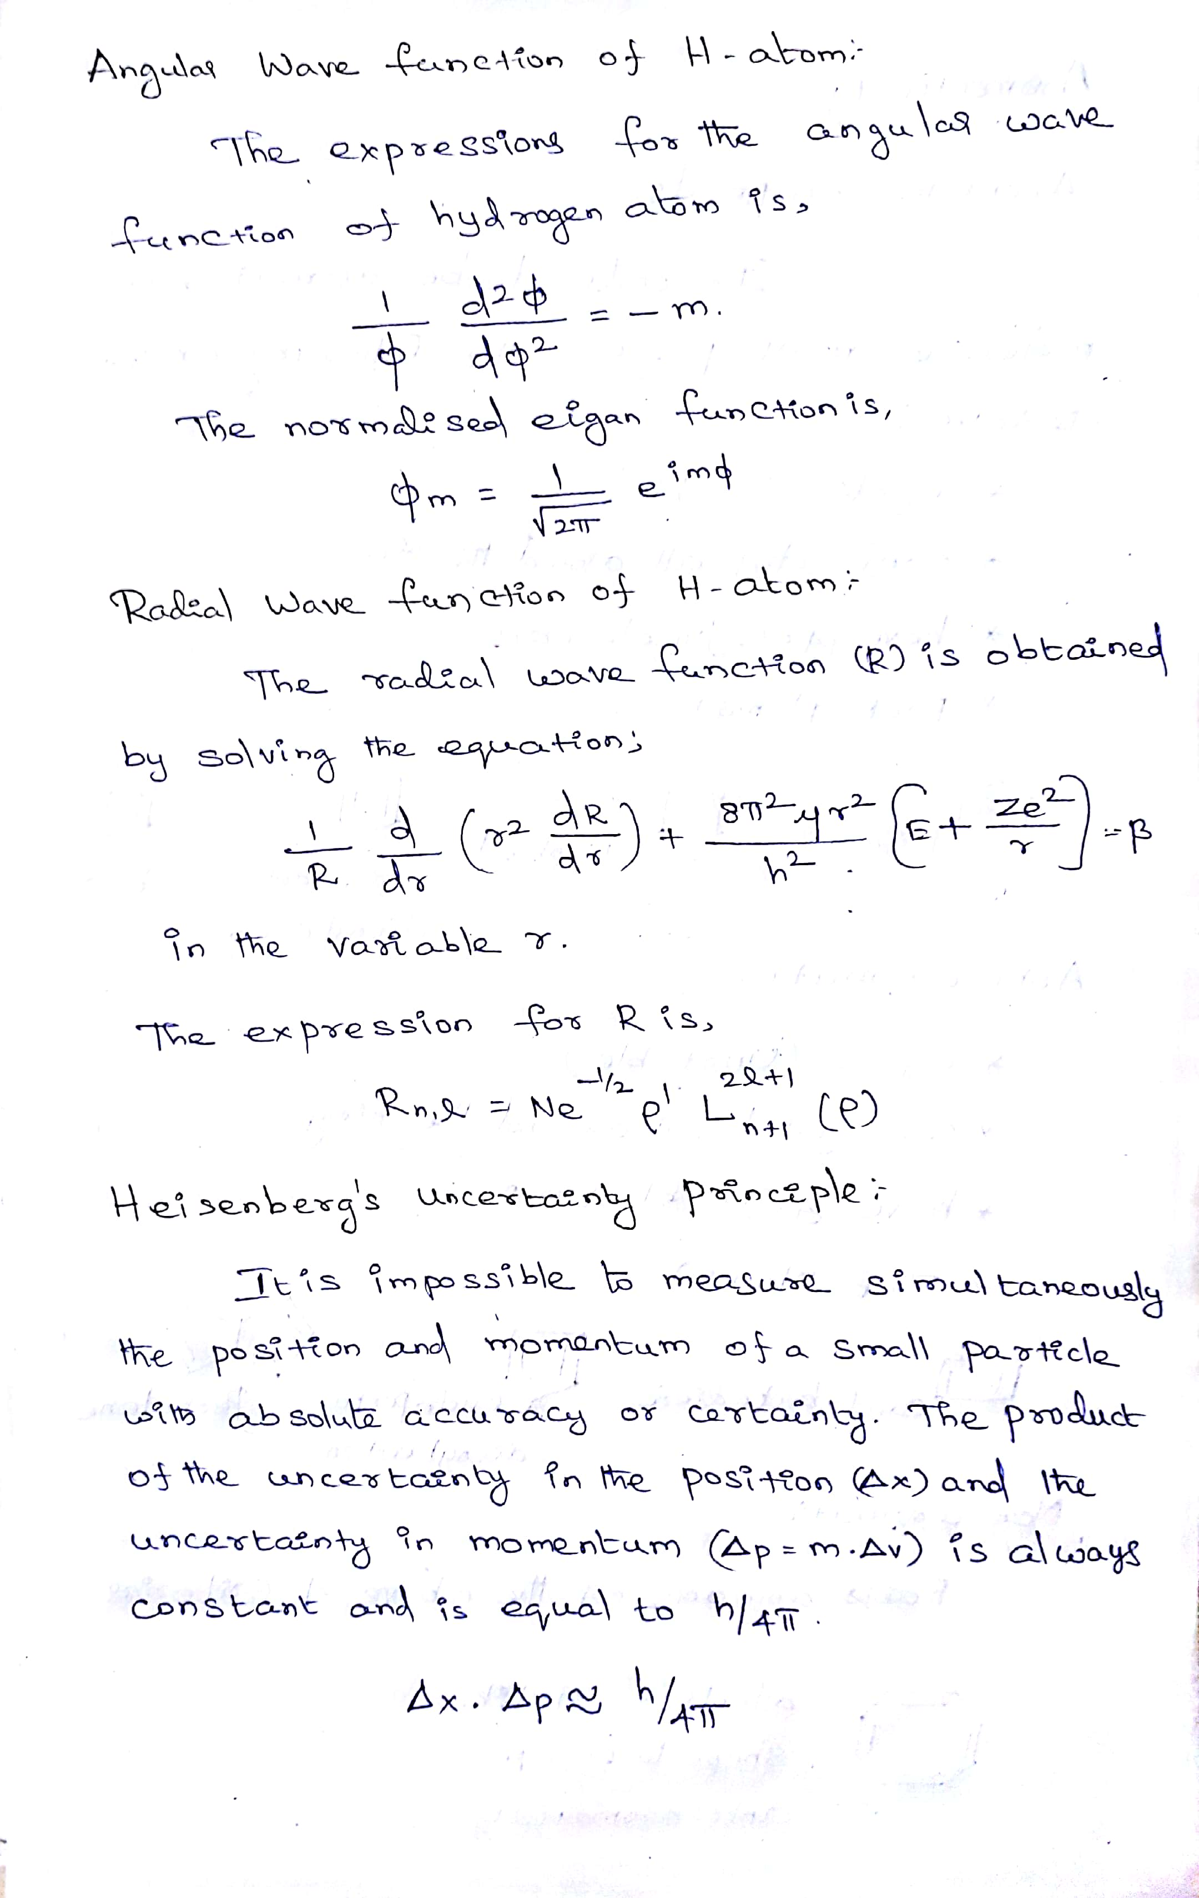

Slide 10
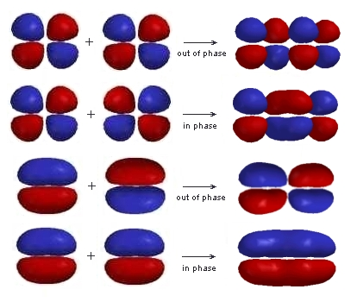
π Molecular Orbitals of 1,3-Butadiene
1,3-Butadiene contains two double bonds that are conjugated.
It is "built" from 4 sp² hybridsed C atoms, each contributing a p atomic orbital containing 1 electron.
An alternative way to consider "building" the π molecular orbitals is by combining the π molecular orbitals of two ethene molecules.
This requires that we make an in-phase and an out-of-phase combination for both the π and π* of ethene.
Either way, we end up with the same set of 4 π molecular orbitals.

Slide 11
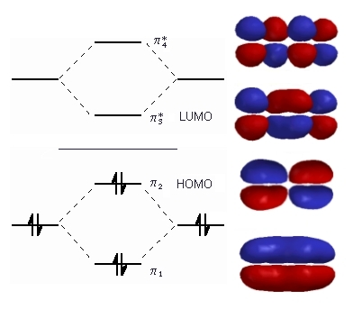
The relative energies of these orbitals can be accounted for by counting the number of bonding and anti-bonding interactions in each:
π1 has bonding interactions between C1-C2, C2-C3 and C3-C4
Overall = 3 bonding interactions
π2 has bonding interactions between C1-C2 and C3-C4 but anti-bonding between C2-C3
Overall = 1 bonding interaction
π3 has bonding interactions between C2-C3 but anti-bonding between C1-C2 and C3-C4
Overall = 1 anti-bonding interaction
π4 has anti-bonding interactions between C1-C2, C2-C3 and C3-C4
Overall = 3 anti-bonding interactions

Slide 12
π Molecular Orbitals of Benzene
In previous slide we looked at the π molecular orbitals for ethene and 1,3-butadiene.
Now we will look at the π molecular orbitals for benzene. With 6 C atoms contributing to the π system, we need to create 6 molecular orbitals. These are shown below. The most stable orbital, π₁, is the all in-phase combination. We then have two orbitals, π₂ and π₃, that are still bonding but each with one node. There are then two orbitals π₄ and π₅, that are anti-bonding each with two nodes. Finally, the least stable orbital, π₆, is the all out-of-phase combination with three nodes.
Once we put the π electrons into these molecular orbitals, we see that maximum stability is being gained because all of the 6 π electrons completely fill the three bonding orbitals. This is referred to as a closed shell π-electron configuration.

Slide 13
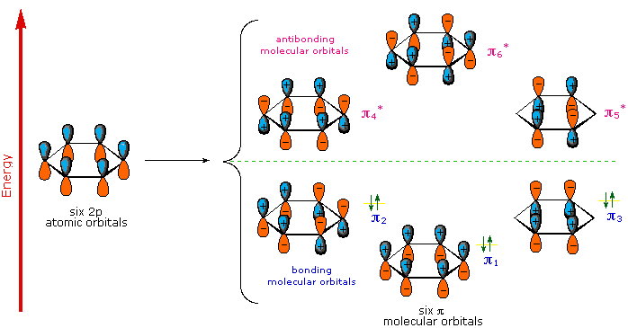
The Molecular Orbitals of Benzene

Slide 14
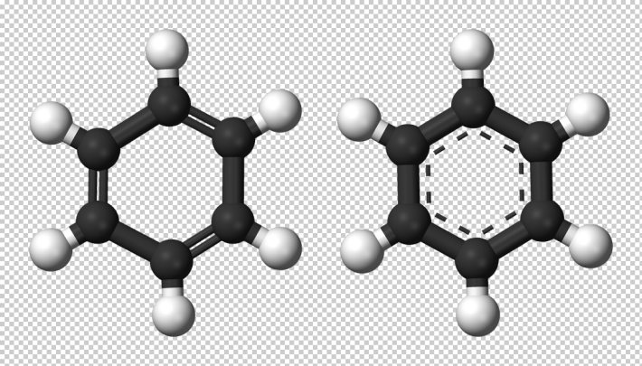
Aromaticity
Aromaticity is defined as a property of the conjugated cycloalkenes which enhances the stabilization of a molecule due to its ability of electrons present in the ππ orbitals for the purpose of delocalization.
Aromatic molecules are said to be very stable and they do not break so easily and also reacts with other types of substances. The organic compounds which are not said to be aromatic are known as aliphatic compounds. These might be in cyclic form, but only the aromatic rings have a special kind of stability.
Aromaticity Examples
Benzene 3D ball structure

Slide 15
Aromaticity Rules
Aromatic compounds are less stable compounds and they have many kinds of chemical as well as synthetic uses. In fact, the nucleic acids and the amino acids that make up our cell structure make use of these aromatic compounds. But, the main thing is what makes aromatic compounds? The aromatics compounds are said to exhibit some of the special characteristics or called as rules which are given below-
The aromatic compounds are always cyclic structures.
Each element of the ring within the structure must and should have a p-orbital ring which is in a perpendicular form to the ring, and this makes it a planar molecule
All the compounds obey the Huckel’s Rule, i.e all the aromatic compounds should have the (4n+2) Pi number of electrons.
The last one is that the organic compound has to be flat.

Slide 16
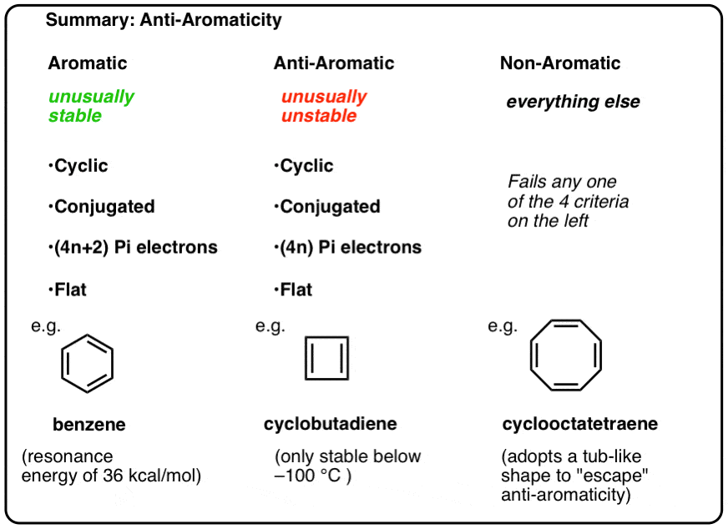

Slide 17
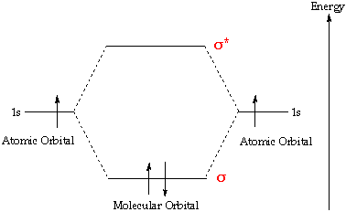
Molecular orbital (MO) theory
Molecular orbital (MO) theory is a method for describing the electronic structure of molecules using quantum mechanics. The spatial and energetic properties of electrons are described by quantum mechanics as molecular orbitals surround two or more atoms in a molecule and contain valence electrons between atoms.
According to the Molecular Orbital Theory, individual atoms combine to form molecular orbitals. Thus the electrons of an atom are present in various atomic orbitals and are associated with several nuclei.

Slide 18
Linear Combination of Atomic Orbitals (LCAO)
As per this method, the formation of orbitals is because of Linear Combination (addition or subtraction) of atomic orbitals which combine to form the molecule. Consider two atoms A and B which have atomic orbitals described by the wave functions Ψ_{A} and Ψ_{B}.
If the electron cloud of these two atoms overlaps, then we can obtain the wave function for the molecule by a linear combination of the atomic orbitals Ψ_{A} and Ψ_{B.} The below equation forms two molecular orbitals.
Ψ_{MO} = Ψ_{A} + Ψ_{B}
Bonding Molecular Orbitals
Ψ_{MO} = Ψ_{A} + Ψ_{B.}
Anti-Bonding Molecular Orbitals
Ψ_{MO} = Ψ_{A} – Ψ_{B.}

Slide 19
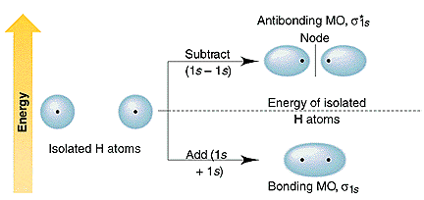
Formation of Bonding and Anti-Bonding Orbital
Therefore, Combination of two atomic orbitals results in formation of two molecular orbitals, bonding molecular orbital (BMO) whereas other is anti-bonding molecular orbital (ABMO).

Slide 20
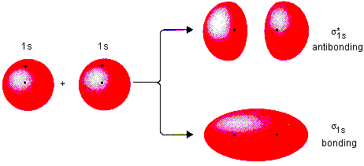
Molecular orbitals are obtained by combining the atomic orbitals on the atoms in the molecule. Consider the H₂ molecule, for example. One of the molecular orbitals in this molecule is constructed by adding the mathematical functions for the two 1s atomic orbitals that come together to form this molecule. Another orbital is formed by subtracting one of these functions from the other, as shown in the figure below.

Slide 21
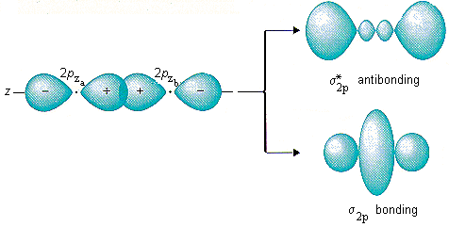
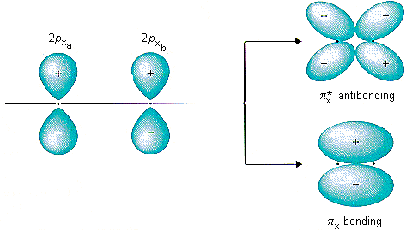

Slide 22
Energy Level Diagram
The factors upon which relative energies of molecular orbitals depend are:
(i) Energies of the Atomic orbitals combining to form Molecular Orbitals.
(ii) The extent of overlapping between the atomic orbitals. The greater the overlap, the more the bonding orbital is lowered and the anti-bonding orbital is raised in energy relative to AOs
1s Atomic Orbitals (AOs) of two atoms form two Molecular Orbitals (MOs) designated as σ 1s and σ*1s.The 2s and 2p orbitals (eight AOs of two atoms) form four bonding MOs and four anti-bonding MOs as:
Bonding MOs: σ 2s, σ 2pz, π 2p_{x}, π 2p_{y}
Anti – Bonding MOσ: σ *2s, σ *2p_{z}, π *2p_{x}, π *2p_{y}

Slide 23
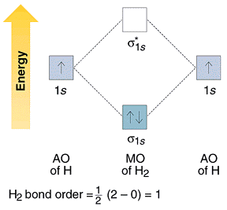
Molecular Orbitals of H₂
The molecular orbital approach is one explanation for the H−HH−H bond. This explanation is based on a mathematical model, hence it is a theory.
Each orbital accommodates two electrons, and the two electrons in H−H fill the s_{1s} molecular orbital (MO). Obviously, as a result of the formation of the H2 molecule, the energy of the system is lowered and becomes more stable.

Slide 24
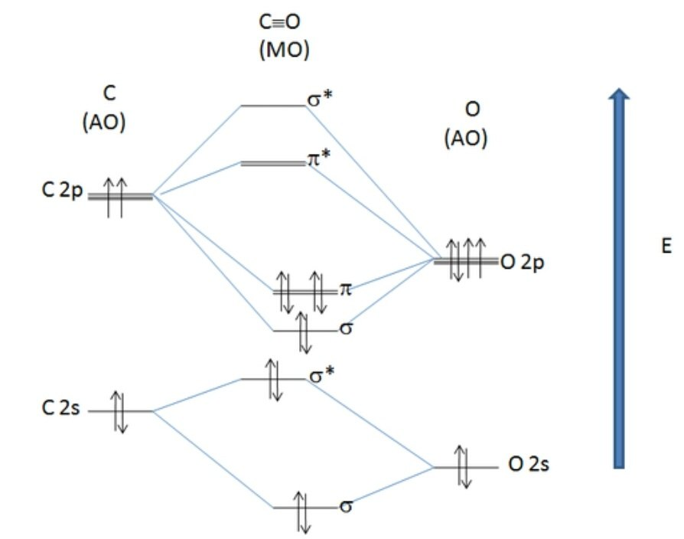
Molecular Orbitals of CO
Bond Order
It may be defined as the half of difference between the number of electrons present in the bonding orbitals and the antibonding orbitals that is,
Bond order (B.O.) = (No. of electrons in BMO - No. of electrons in ABMO)/ 2
Bond order = 1/2(8–2) = 3
Magnetic Behavior: If all the molecular orbitals in species are spin paired, the substance is diamagneti. But if one or more molecular orbitals are singly occupied it is paramagnetic. For Example, if we look at CO Molecule, it is diamagnetic as all the electron in CO are paired as in the figure below:

Slide 25
CRYSTAL FIELD THEORY
The valence bond theory could not explain the stability of the coordination compounds. It also failed to throw a light on the differences between strong and weak ligands. Therefore, scientists proposed the crystal field theory.
According to this theory, the metal-ligand bond acts as an ionic bond arising purely from the electrostatic interactions between the metal ions and ligands. This theory takes anions as point charges and neutral molecules as dipoles. When the transition metals do not bond to any ligand, their d orbitals degenerate. This means that they have the same amount of energy.
When they start bonding with other ligands, the d orbitals split apart and become non-degenerate. This bonding occurs mainly due to different symmetries of the d orbitals and the inductive effect of the ligands on the electrons. The pattern of the splitting of d orbitals depends on upon the nature of crystal field.

Slide 26
Splitting of Crystal Fields
In case of an octahedral coordination compound, there are six ligands that surround the metal atom/ion. In these cases, we observe repulsion between the electrons in d orbitals and ligand electrons. This repulsion is more in the case of d_{x2-y2} and d_{z2} orbitals. This is because they point towards the axes along the direction of ligand. Hence, their energy is higher as compared to the average energy in spherical crystal field.
While, d_{xy}, d_{yz}and d_{xz} orbitals experience lower repulsions as they are directed between the axes. Hence, these three orbitals possess lower energy than the average energy in spherical crystal field. Thus, we get two energy levels:
t_{2g}– set of three orbitals (d_{xy}, d_{yz} and d_{xz}) with lower energy
e_{g} – set of two orbitals (d_{x2-y2} and d_{z2}) with higher energy

Slide 27
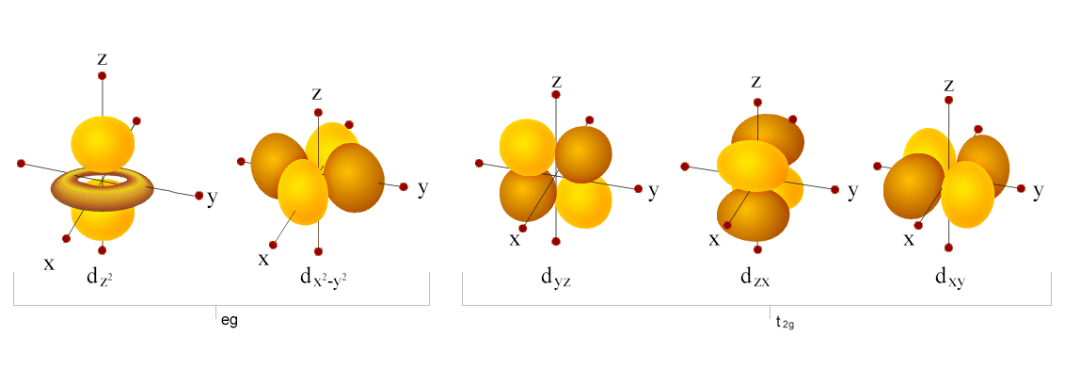
Orbital Splitting:
The five d-orbitals are given the symbols dxy, dzx, dyz, dx²-y² and dz². In a complex they are all differently aligned relative to the incoming charge. Depending on the geometry of the complex, some of the d-orbitals will point directly towards the ligands, while some will point between them. Those which point at the ligands will experience more repulsion between their own electrons and those of the incoming ligands, than will those which do not point directly at them. Thus, the orbitals pointing at the ligands will be less stable and higher in energy. Now all the d-orbitals are no longer equivalent, giving rise to the phenomenon of orbital splitting, and the difference in energy between the more and less repelled orbitals is called the crystal field splitting parameter.

Slide 28
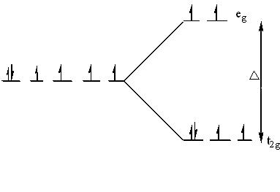
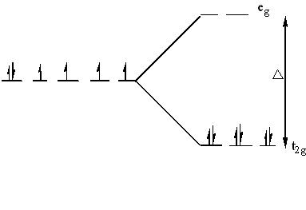
The electrons can go into either a high spin or low spin arrangement depending on the magnitude of the crystal field splitting energy.
High spin
Low spin

Slide 29
The Spectrochemical Series:
The variation of the magnitude of the crystal field splitting (Δ) with the nature of the ligand follows a regular order, known as spectrochemical series. This series is given below in the order in which they produce increasing value of Δ.
I- < Br- < S22-< SCN- <cl- < N3- < F- < urea, OH- < ox, O2- < H2O < NCS- < py, NH3 < en < bipy, phen < NO2- < CH3-, C6H5-< CN- </cl
Weak field ligands have small Δ and will form high spin complexes.
Strong field ligands have large Δ and will form low spin complexes.

Slide 30
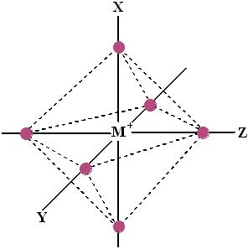
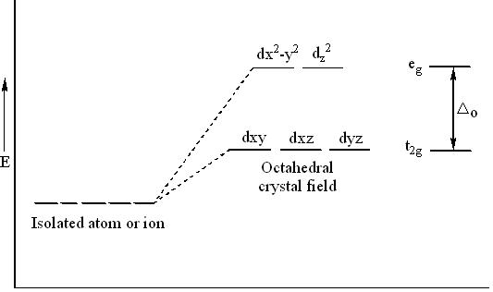
Octahedral Complexes:
The octahedral arrangement of six ligands surrounding the central metal ion is as shown in the figure.

Slide 31
In an octahedral complex, the metal ion is at the centre and the ligands are at the six corners. In the figure, the directions x, y and z point to the three adjacent corners of the octahedran. The lobes of the eg orbitals (dx2-y2 and dz2) point along the x, y and z axis while the lobes of the t2g orbitals (dxy, dzx and dyz)point in between the axes. As a result, the approach of six ligands along the x, y z, -x,-y and –z directions will increase the energy of dx2-y2 and dz2 orbitals (which point towards the ligands) much more than that it increases the energy of dxy, dzx and dyz orbitals ( which point in between the metal-legand bond axis).
Thus, under the influence of an octahedral field, the d orbitals split into triply degenerate orbitals with less energy and another as doubly degenerate orbitals with higher energy. The main energy level between these two sets of orbitals is taken as zero, which is called bari centre. The splitting between these two orbitals is called crystal field splitting. The magnitude of stabilization will be 0.4 Δo and the magnitude of destabilization will be 0.6 Δo.

Slide 32
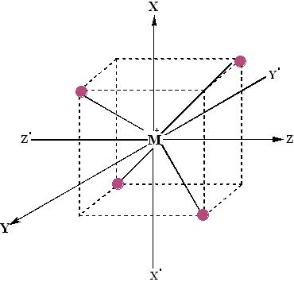
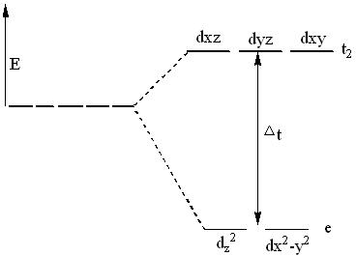
Tetrahedral Complex:
The tetrahedral arrangement of four ligands surrounding the metal ions is as shown in the figure.

Slide 33
A regular tetrahedron is a cube. One atom is at the centre of the cube and four of the eight corners of the cube are occupied by ligands. The directions x, y and z point to the face centres. The dx2-y2 and dz2 orbitals point along the x, y and z directions and dxy, dzx and dyz orbitals point in between x, y and z directions.
The direction of approach of ligands does not coincide exactly with either the e or t2 orbitals. The t2 orbitals are pointing close to the direction in which the e orbitals are lying in between the ligands. As a result, the energy of t2 orbitals increases compared to the energy of e orbitals. Thus, d orbitals again split into two sets- triply degenerate t2 of higher energy and doubly degenerate e orbitals of lower energy. That is, t2 orbitals are raised by 0.4 Δt in energy and the e orbitals are stabilized by 0.6 Δt in energy.
The energy difference between the two sets of orbitals (Δt) will be about half the magnitude of that in an octahedral complex (Δo).

Slide 34
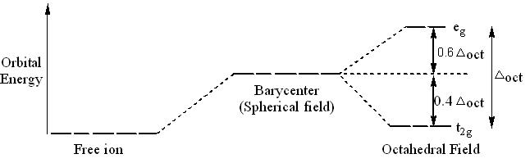
Crystal Field Stabilization Energy:
The crystal field stabilization energy (CFSE) is the stability that results from placing a transition metal ion in the crystal field generated by a set of ligands. It arises due to the fact that when the d-orbitals are split in a ligand field (as described above), some of them become lower in energy than before with respect to a spherical field known as the bari centre in which all five d-orbitals are degenerate. For example, in an octahedral case, the t2g set becomes lower in energy than the orbitals in the bari centre. Owing to the splitting of the d orbitals in a complex, the system gains an extra stability due to the rearrangement of the d electrons filling in the d levels of lower energy. The consequent gain in bonding energy is known as crystal field stabilization energy (CFSE).

Slide 35
Magnetism of transition metal complexes
Compounds with unpaired electrons have an inherent magnetic moment that arises from the electron spin. Such compounds interact strongly with applied magnetic fields.
Their magnetic susceptibility provides a simple way to measure the number of unpaired electrons in a transition metal complex. If a transition metal complex has no unpaired electrons, it is diamagnetic and is weakly repelled from the high field region of an inhomogeneous magnetic field.
Complexes with unpaired electrons are typically paramagnetic. The spins in paramagnets align independently in an applied magnetic field but do not align spontaneously in the absence of a field. Such compounds are attracted to a magnet, i.e., they are drawn into the high field region of an inhomogeneous field. The attractive force, which can be measured with a Guoy balance or a SQUID magnetometer, is proportional to the magnetic susceptibility (χ) of the complex.

Slide 36
The effective magnetic moment of an ion (µ_{eff}), in the absence of spin-orbit coupling, is given by the sum of its spin and orbital moments:
µ_{eff} = µ_{spin} + µ_{orbital} = µ_{s} + µ_{L}
In octahedral 3d metal complexes, the orbital angular momentum is largely "quenched" by symmetry, so we can approximate:
µ_{eff} ≈ µ_{s}
We can calculate µ_{s} from the number of unpaired electrons (n) using:
Here µ_{B} is the Bohr magneton (= eh/4πm_{e}) = 9.3 x 10⁻²⁴ J/T. This spin-only formula is a good approximation for first-row transition metal complexes, especially high spin complexes.

